Slide 1


HOTEL X
Abdullateef Adebiyi
Hotel Reservation Analysis with SQL

Slide 2
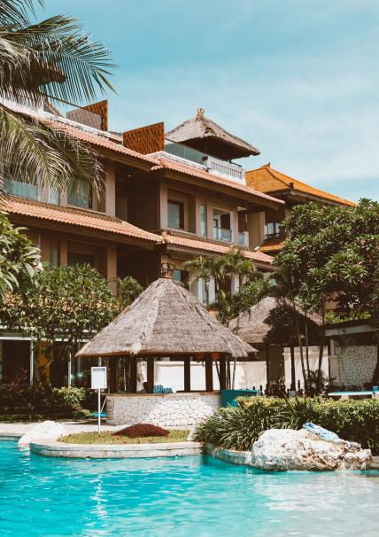
HOTEL X
Introduction
A hotel is a commercial establishment that provides lodging, meals, and other guest services for travelers and tourists. Hotels offer a range of accommodations from basic rooms with minimal amenities to luxurious suites with extensive facilities.
The primary purpose of a hotel is to offer a temporary place of stay that meets the comfort, convenience, and privacy needs of its guests, whether they are on vacation, business trips, or any other form of travel.
In the quest to improve customers' satisfaction, facilities, and amenities which in turn would upgrade the standard of Hotel X, Hotel X sorts information and some answers from the hotel's reservation dataset to make informed decisions.
MySQL, a relational database tool that uses SQL (Structured Query Language) for managing and manipulating relational databases is used to perform exploratory data analysis on the hotel's dataset by writing queries and analyzing the data to achieve the objectives mentioned above.

Slide 3

Actionable Insights
guest preferences
booking trends
reservations
Meal plan
Room type
Booking status
Days, months, year
Number of reservations,
Adults, Children

Slide 4
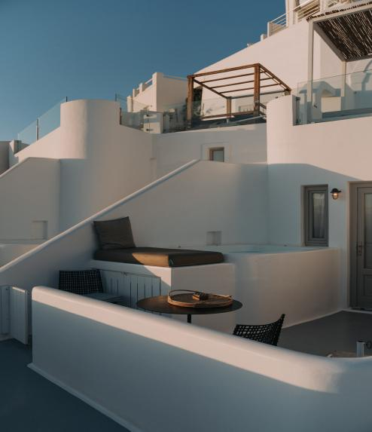
HOTEL X
Approach towards Dataset
The dataset was studied to have a better understanding of the data. Patterns and anomalies were identified. Then Data cleaning was performed to remove duplicates and correct inconsistencies and anomalies.
The dataset includes Booking_ID, the number of adults and children, and other specifics.

Slide 5
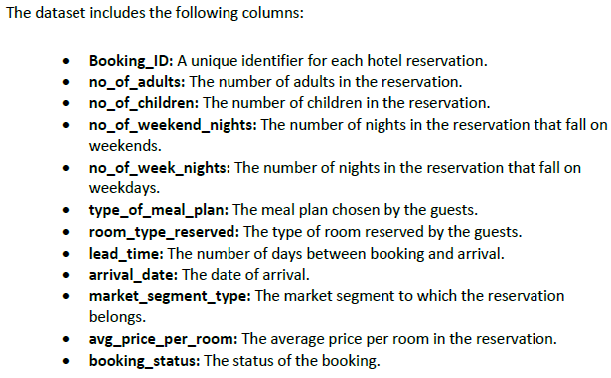
HOTEL X
Dataset Details

Slide 6

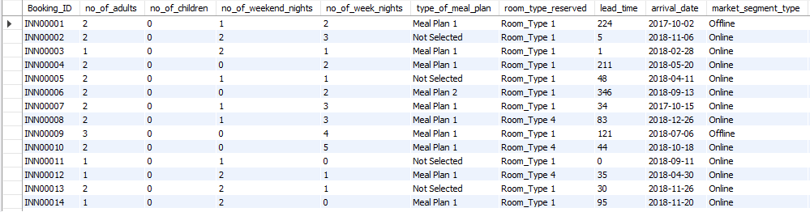
HOTEL X
QUERIES TO
GET
INSIGHTS

Slide 7
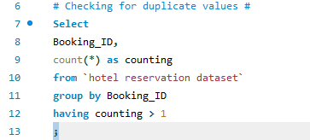
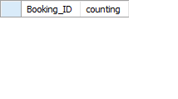
HOTEL X
QUERIES TO GET INSIGHTS
Part of data cleaning is looking out for duplicated
records;
REMOVING DUPLICATE BY USING GROUP BY

Slide 8
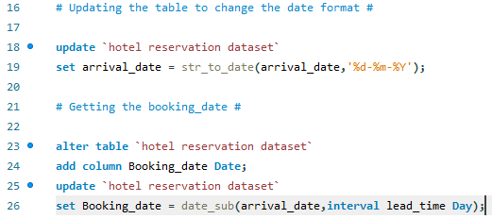
HOTEL X
Updating and
Data Manipulation
The arrival year is converted to SQL year format.
Booking date column is created using the lead time and arrival date.

Slide 9
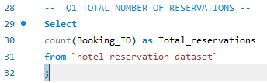
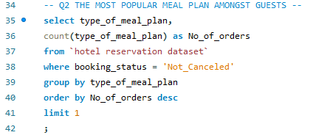


HOTEL X
QUERIES

Slide 10
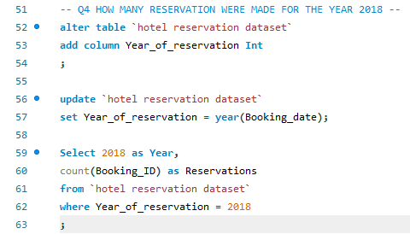
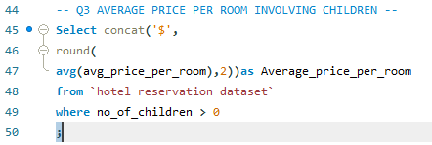


HOTEL X
QUERIES

Slide 11
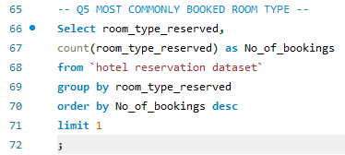
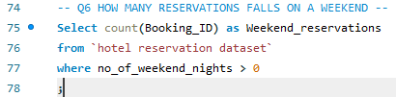


HOTEL X
QUERIES

Slide 12
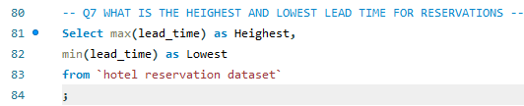
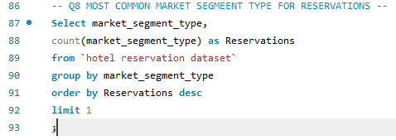


HOTEL X
QUERIES

Slide 13
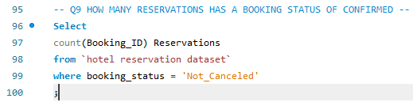
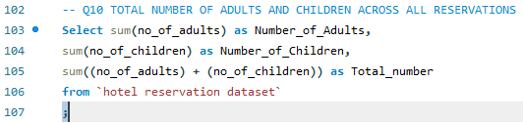


HOTEL X
QUERIES

Slide 14
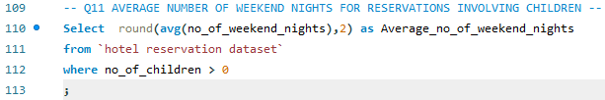

HOTEL X
QUERIES

Slide 15
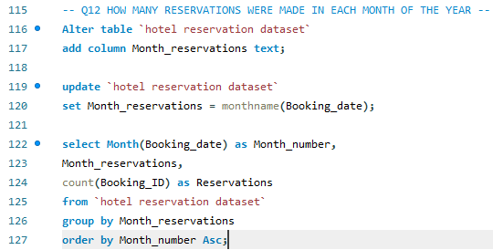
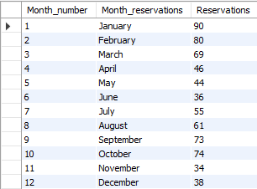
HOTEL X
QUERIES

Slide 16
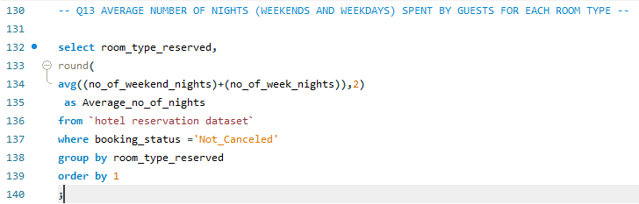
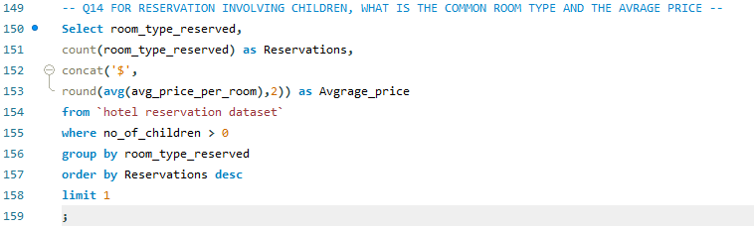
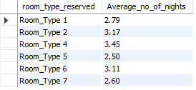

HOTEL X
QUERIES

Slide 17
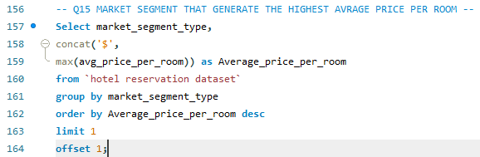

HOTEL X
QUERIES

Slide 18

HOTEL X
Insights
700 total reservations were made.
Of the three meal plans, Meal Plan 1 is the most popular among guests . It was ordered 377 times.
The average price per room involving children is $144.75.

Slide 19
In 2018, 500 reservations were made which is more than half of the total reservations
The most commonly booked room type is Room type 1. It has 534 bookings.
383 reservations fall on weekends.
443 is the highest lead time for reservation while 0 is the lowest.
518 reservations from the online market segment make it the most common market segment type.
493 reservations were confirmed.
The total number of adults and children across all reservations is 1385.
Average number of weekend nights involving children is 1.00.
90 reservations were made in January.
Room types 4 and 5 have the highest and lowest average number of night in both weekends and weekdays with 3.45 and 2.50 respectively.
The common room type with children is room type 1 and the average price is $123.12
Online market segment generate the highest average price per room at $258

Slide 20
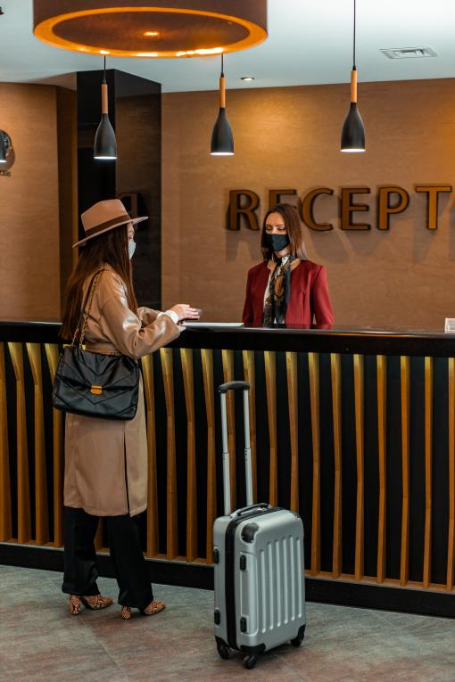

HOTEL X
Recommandation
Meal plan 2 and the other meal plans should be revisited. 76.47%
of the 493 guests ordered Meal Plan 1. When 81 guests did not place any orders. 7.10% of the guests went for Meal Plan 2. Provision of children’s meals should be included in the meal plan too, this way the average number of nights involving children’s reservations will increase from 1 night.
76.29% of the reservations were for Room type 1, proper planning should be considered for the other 5 rooms such as;
refurbishing, provision of smart gadgets, children-friendly materials.

